Slide 1
JOURNEY PPT
Custom IDA
25 Sept 2023 – 29 Sept 2023
- Musaddiq Shariff

Slide 2
Week 6: Day -1 – Pyspark
Data cleaning and filtering
Handling null-values
Transforming data with example
Reading data from given dataset(file/table)
Clean and transform data

Slide 3
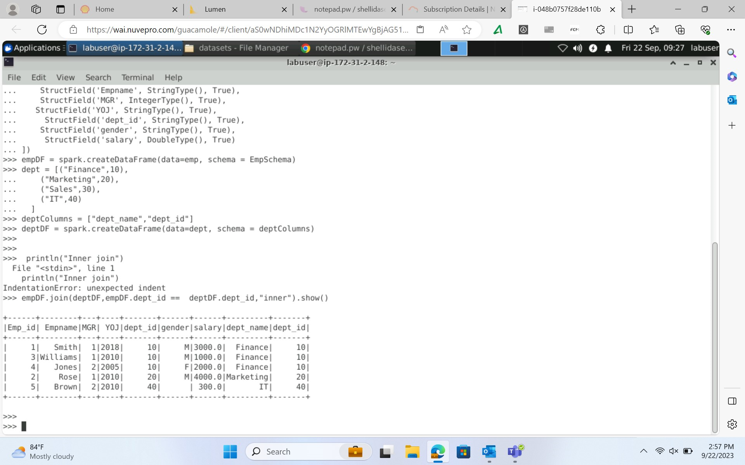
PySpark

Slide 4
Day – 2 Databricks
Introduction to Databricks
workspace creation, Notebook, Library and Repos
Computation Management: cluster, pool
Azure databricks using PySpark and Spark SQL
Dataframes and DBFS in Azure Databricks
Creating first Notebook and connect to datalake
Read and write file to DataLake

Slide 5
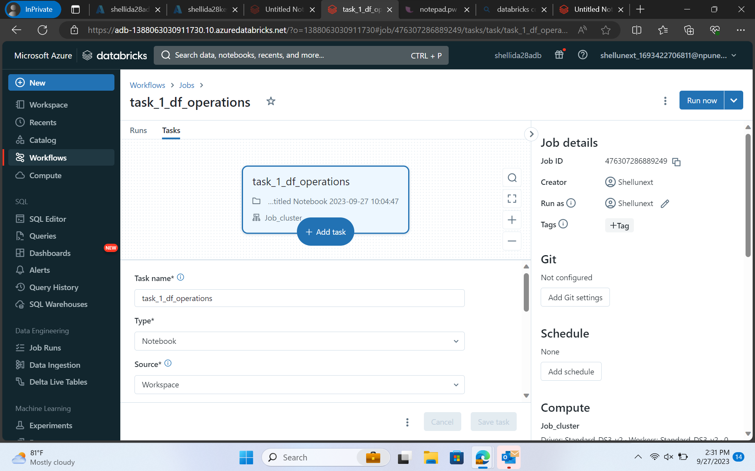
Databricks

Slide 6
Day 3 - Databricks
Security and protection
ADB Integration with other services(synapse, SQL DB, Power BI)
Delta Lake concept and error handling
Overview on Azure Databricks unity catalog
Introduction and setting up Azure SQL Endpoint
SQL Analytics for querying data within data platform

Slide 7
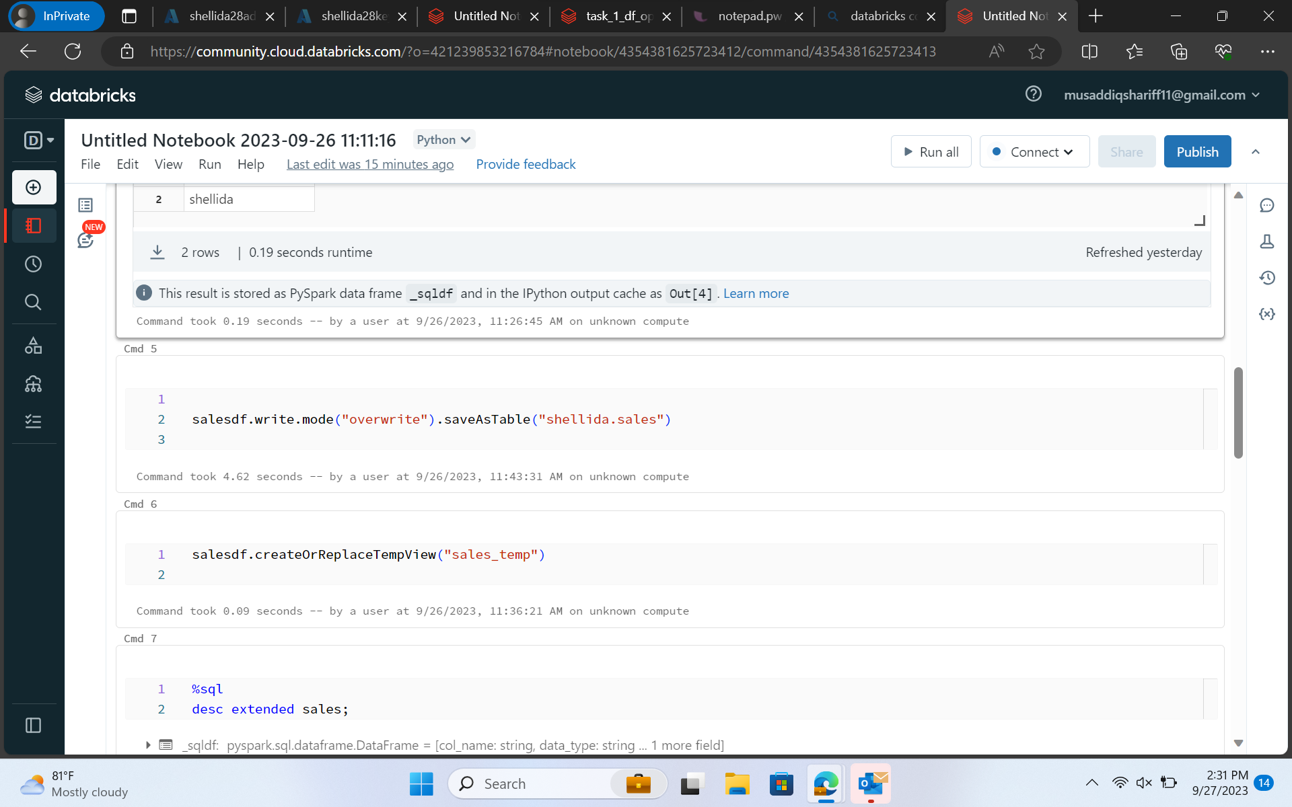
Databricks

Slide 8
Day 4 – Azure Docker Container
Azure Containers- Docker
Security and protection
ADB Integration with other services(synapse, SQL DB, Power BI)
Delta Lake concept and error handling
Overview on Azure Databricks unity catalog
Introduction and setting up Azure SQL Endpoint
SQL Analytics for querying data within data platform

Slide 9
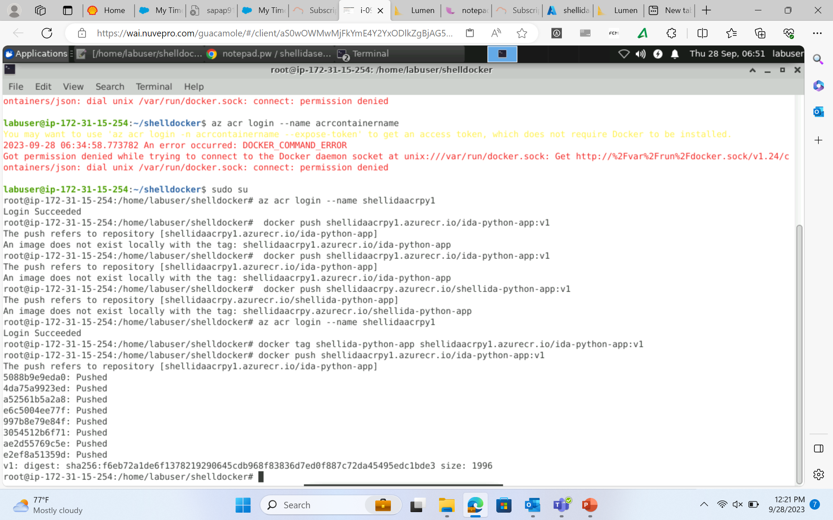
Azure Docker Container

Slide 10
Day 5 - Azure DevOps
Introduction to Azure Deployment
Understanding and implementing DevOps practices
Introduction to CI/CD
Introduction to Git and GitHub
GitHub as Azure platform
GitHub actions and CI/CD
GitHub repo and branching

Slide 11
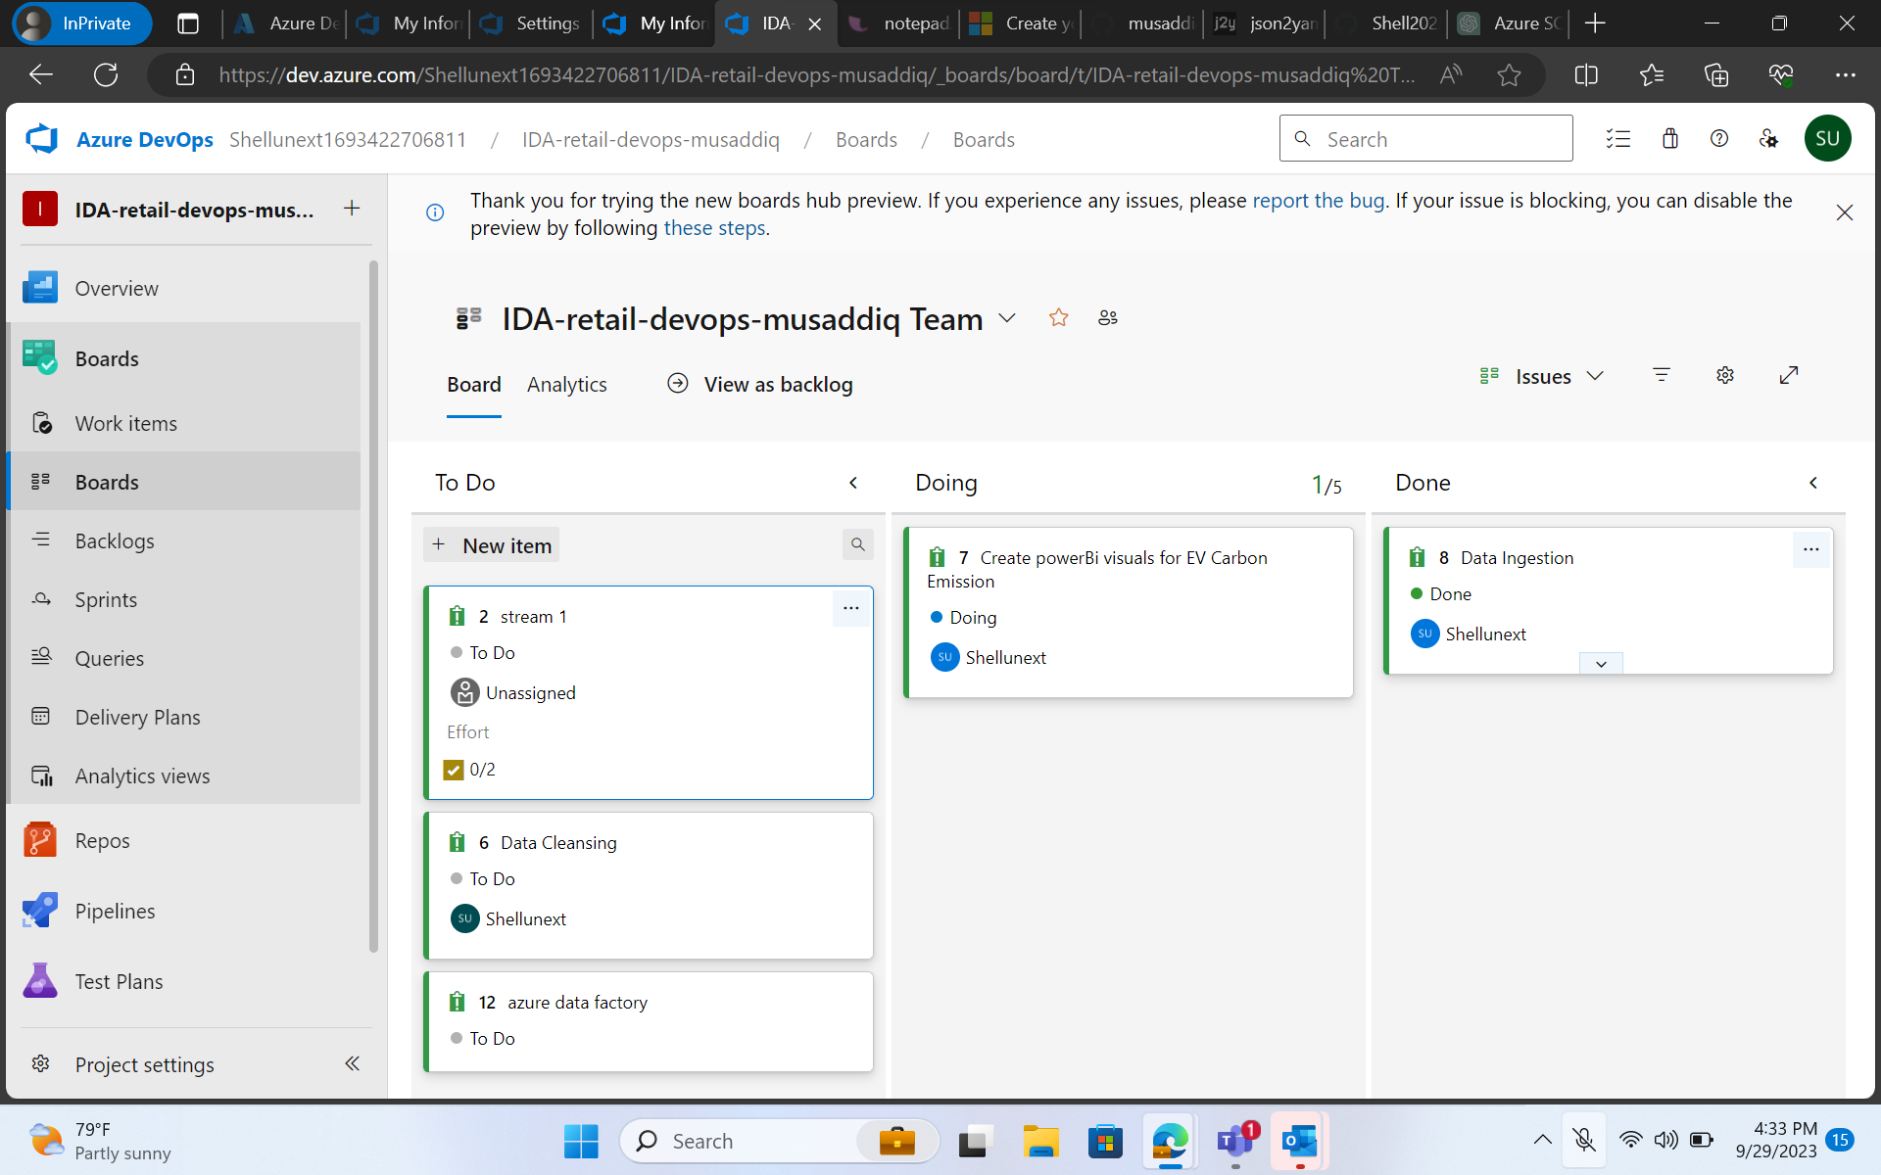
Azure Devops

